Slide 1
Travel time prediction with model selection: an empirical study
Chih-Chia, Hsu
Advisor: Fan Wu Ph.D.

Slide 2
Introduction

Slide 3
Introduction: Background
Recently, travel time prediction has been an important issue in intelligent transportation system, especially for handling congestion problems.

Slide 4
Introduction: Background
According to the 2015 urban mobility scorecard (2015), in 2014, the congestions in America had caused $160 billion congestion cost and wasted Americans 6.9 billion hours during the congestions.
→Travel time prediction is worthy of study and is beneficial to society.

Slide 5
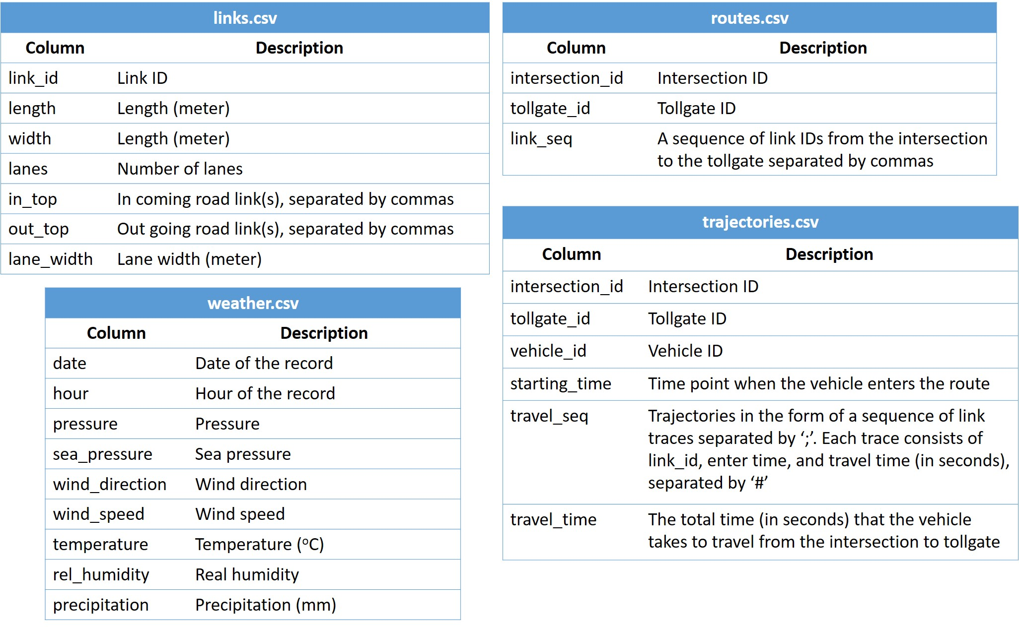
Methods for travel time prediction: Data collection
Without loss of generality, we use KDDCUP 2017’s traffic-flow prediction dataset in the data collection step.
The adopted four files of the dataset are routes.csv, links.csv, trajectories.csv, and weather.csv.

Slide 6
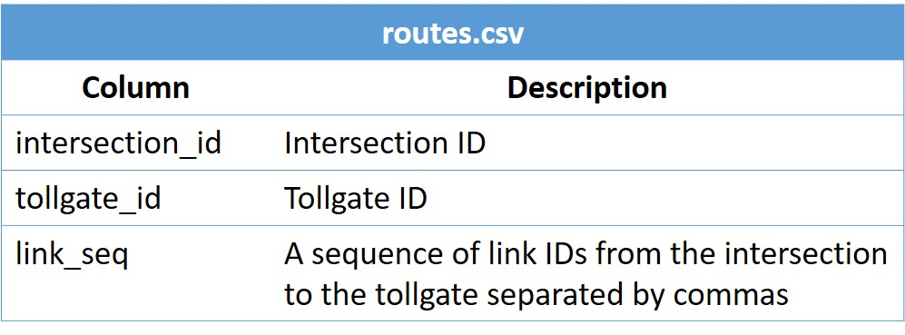
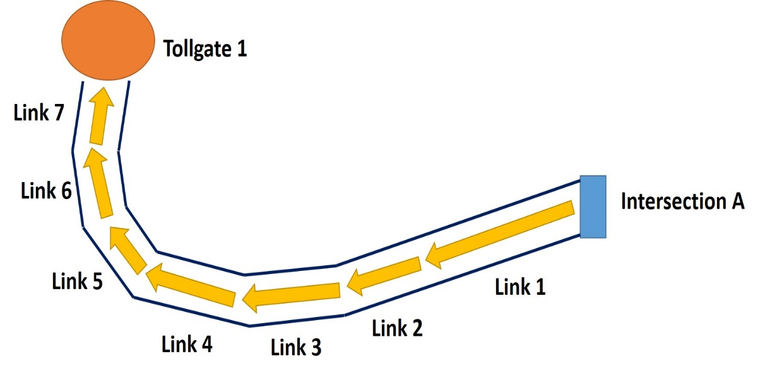
Methods for travel time prediction: Data collection
Intersection_id | tollgate_id | link_seq
A | 1 | 1,2,3,4,5,6,7

Slide 7
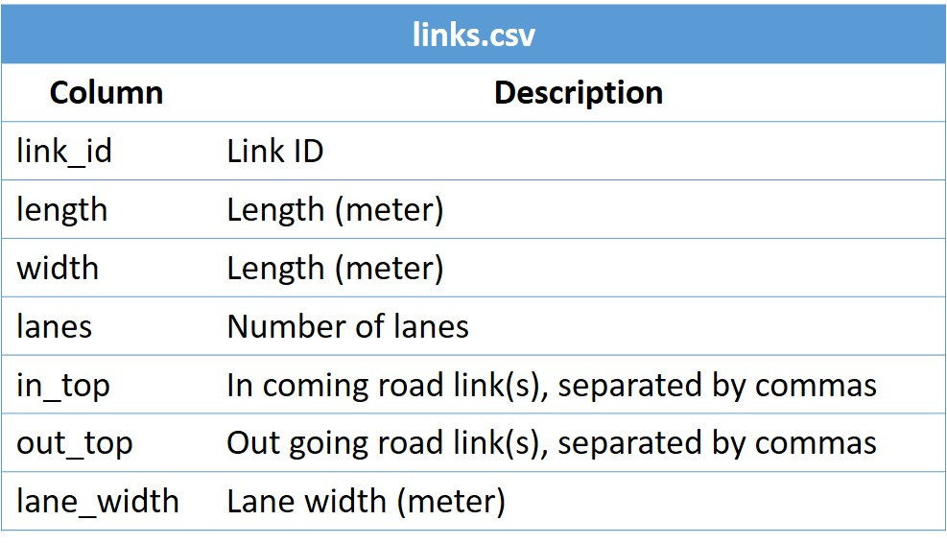

Methods for travel time prediction: Data collection
link_id | Length | Width | lanes | in_top | out_top | lane_width
2 | 100 | 9 | 3 | 1 | 3 | 3

Slide 8
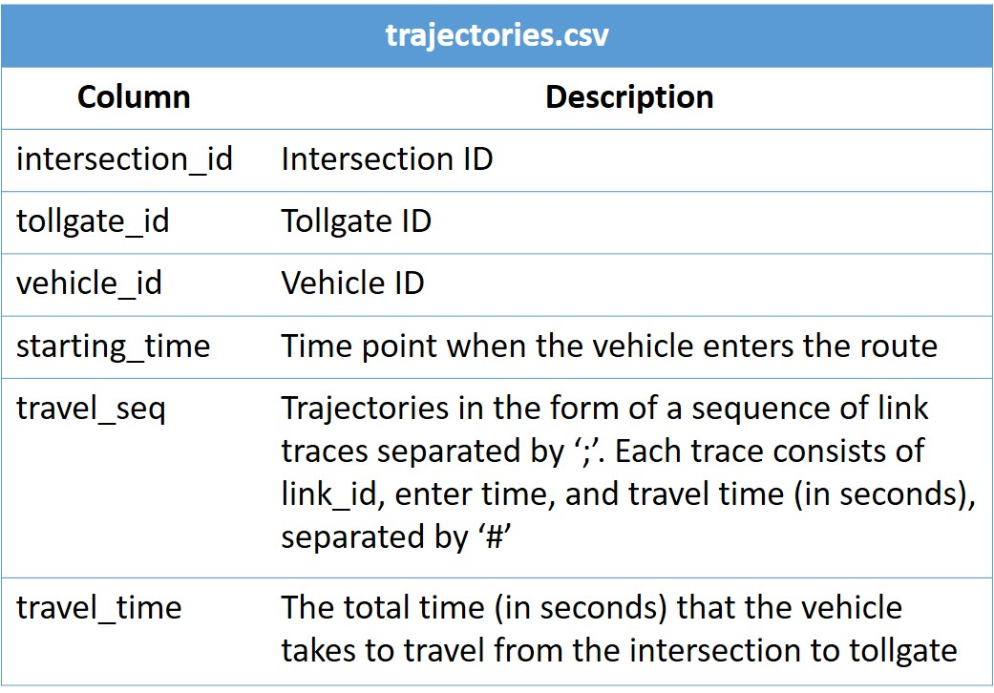

Methods for travel time prediction: Data collection
Start time
2016-06-06
12:23:31
Travel time
80 seconds
I_id* | T_id* | V_id* | Start_time | travel_seq | Total_time
A | 1 | V1 | 2016-06-06 12:23:31 | 1#2016-06-06 12:23:31#8.5; 2#2016-06-06 12:23:40#19; … 7#2016-06-06 12:24:31#20; | 80

Slide 9
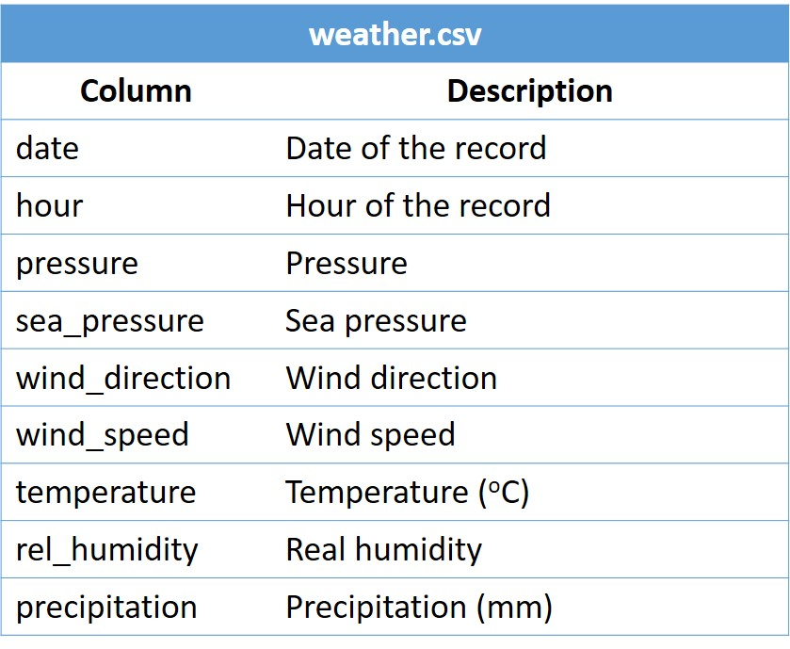

Methods for travel time prediction: Data collection
Precipitation
4 mm
Start time
2016-06-06
12:23:31
Date | hour | pr* | s_p* | w_d* | w_s*4 | t*5 | r_h*6 | Precipitation
2016-06-06 | 12 | 1010 | 1015 | 356 | 3.4 | 20.2 | 86 | 4

Slide 10
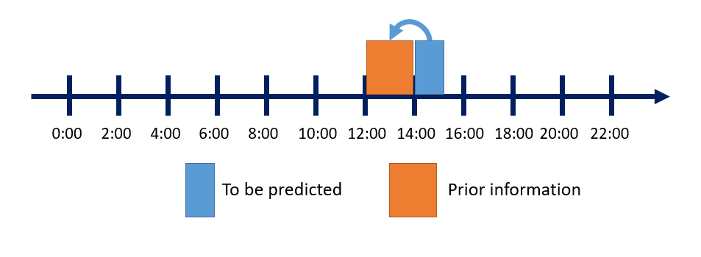
Methods for travel time prediction: Data preprocessing
Feature | Value | Description
Average travel time | Float | The average travel time, measured in seconds
Traffic volume | Integer | The traffic volume
Day of week | 0~6 | 0: Monday, 1: Tuesday, …, 6: Sunday
Workday | 0,1 | 0: not workday, 1: workday
Public holiday | 0,1 | 0: not public holiday, 1: public holiday
Rainfall | Float | The amount of rainfall, measured in millimeter

Slide 11
Methods for travel time prediction: Data preprocessing
Prior information
Current time information
Date | Time slot | Average travel time | Traffic volume | Day of week | Workday | Public holiday | Rain-fall | Minute slot | Target label
2016-06-06 | 14 | 48.3 | 3 | 1 | 1 | 0 | 4 | 4 | 32
2016-06-07 | 14 | 39 | 1 | 2 | 1 | 0 | 0 | 6 | 60
2016-06-08 | 14 | 35 | 1 | 4 | 1 | 0 | 0.8 | 3 | 39

Slide 12
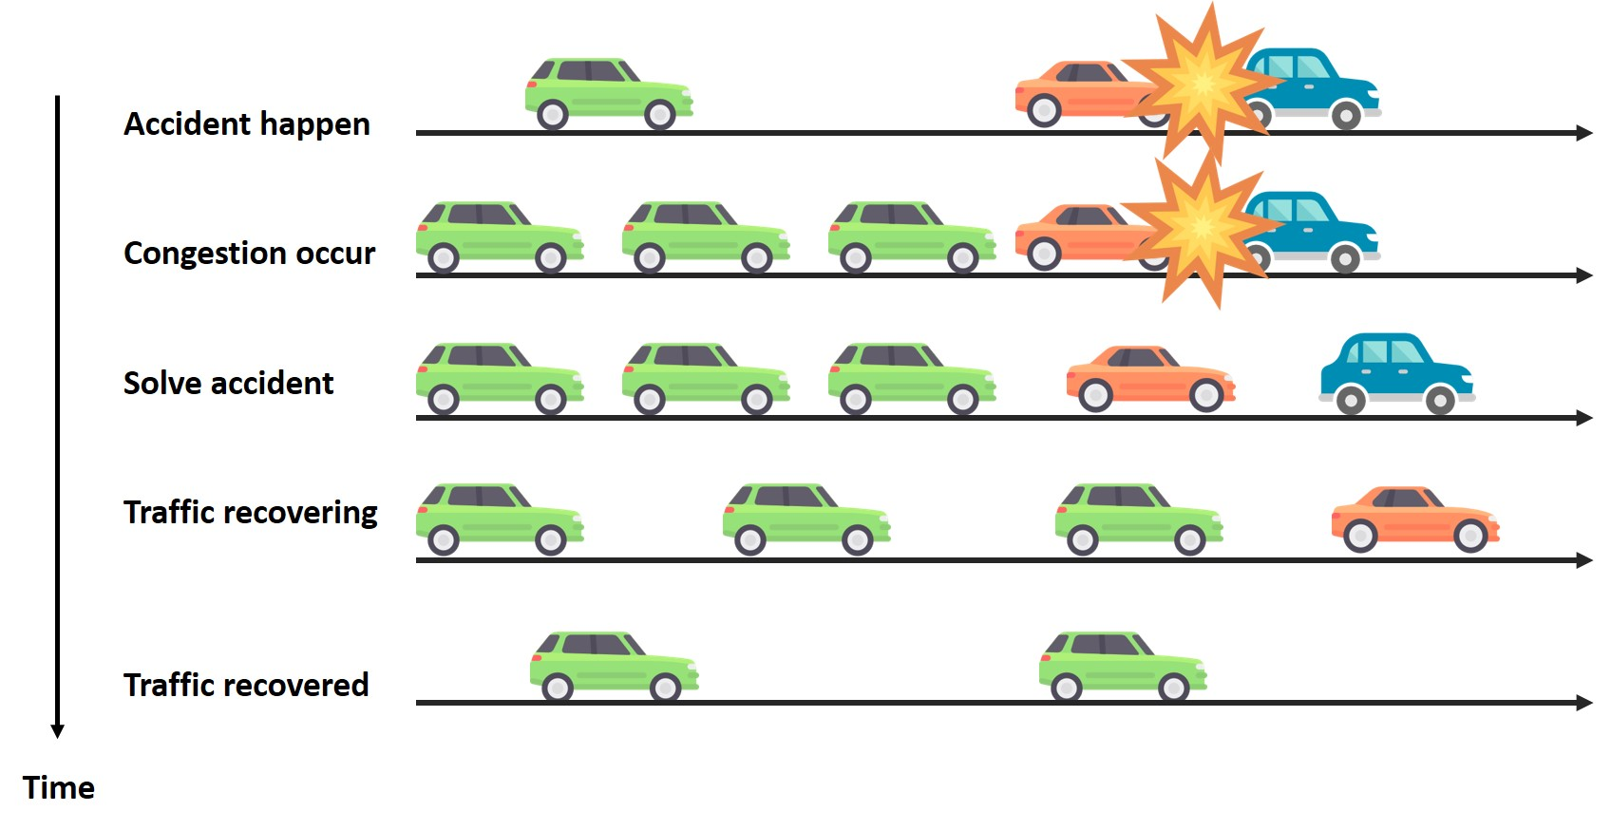
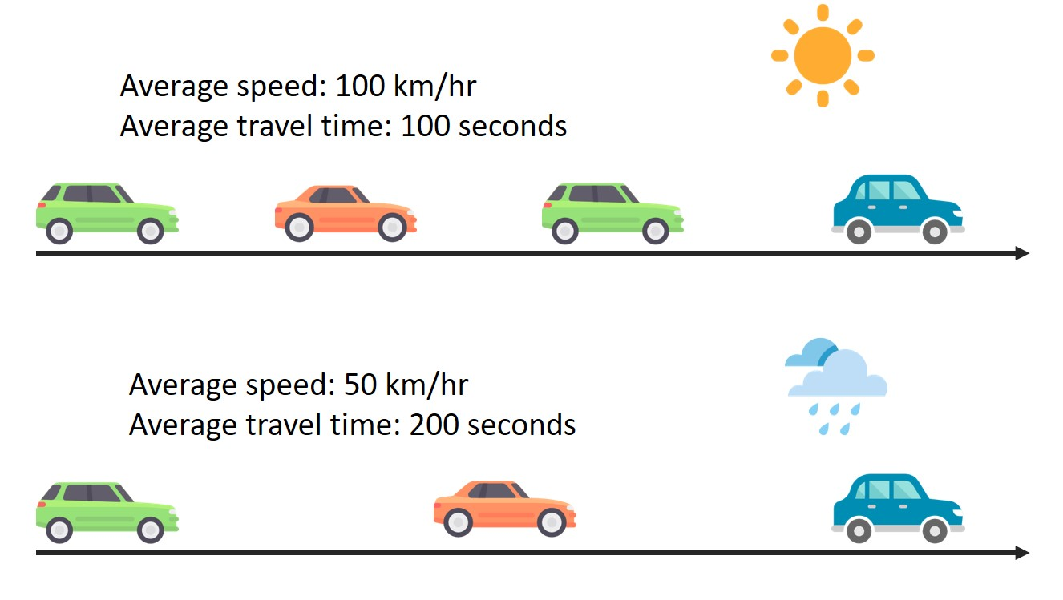
DF approach include two part; the first part (rainfall feature sub-approach) considers rainfall feature, and the second part (current traffic status sub-approach) considers current traffic status.

Slide 13
Thanks for listening

